Slide 1


Telangana Growth Analysis
Presented by Gaurav Nailwal

Slide 2
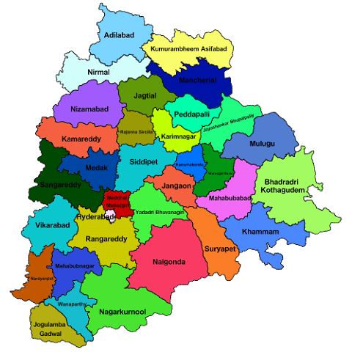
About Telangana
  Telangana is India's youngest state, formed in 2014. capital city is Hyderabad, is a global IT hub with famous landmarks like the Charminar.
  The state has seen fast economic growth, especially in IT, pharmaceuticals, and manufacturing.
  Telugu and Urdu are the official languages.
  Government is focused on digital services, development projects, education.

Slide 3
Business Objective
To analyze the growth of Telangana across multiple sectors — including Stamp Registration, Transportation, and Toll Transactions (TS-I PASS) — using real-time datasets to identify trends, correlations, and opportunities. The goal is to generate actionable insights that support data-driven decision-making by the Telangana State Government, enabling informed policy formulation, resource allocation, and sustainable development planning.
Key Focus Areas:
Analyze monthly, quarterly, and yearly trends in each sector.
Identify high-performing and underperforming districts.
Understand shifts in vehicle sales (especially electric adoption).
Stamp registration and toll revenue to district-level activity.
Correlate inter-departmental performance for holistic insights.

Slide 4
Who can be Stakeholders?
STAKEHOLDERS | INTEREST
Telangana State Government | Overall development, budget allocation
Revenue Department | Stamp registration trends, tax collection
Transport Department | Vehicle ownership, fuel shift, mobility
Highways & Roads Authorities | Toll usage, infrastructure planning
Private Investors | Market opportunities, ROI areas

Slide 5
Dataset Overview
Table name | No. of records | No. of columns | Primary key | Foreign key | Granularity
dim date | 48 | 4 | month | - | monthly level
dim districts | 33 | 2 | dist code | - | district level
fact stamps | 1504 | 6 | - | dist code , month | monthly per districts(each row represents stamp registrations for one district in one month)
fact transports | 1440 | 18 | - | dist code , month | monthly per districts(each row represents transports registrations for one district in one month)
fact TS iPASS | 5753 | 5 | - | dist code , month | monthly per district per sector (each row represents industrial project approvals in a specific sector for a given district and month)

Slide 6
Dataset Overview
Table : dim date
This table contains a list of months with their corresponding abbreviations, quarters, and fiscal years.
Columns :
I) month – The first day of the month in the format dd-mm-yyyy
2) mmm – Abbreviation of the month (e.g., Apr, May).
3) Quarter – The fiscal quarter (e.g., Q1, Q2)
4) Fiscal year - The fiscal year associated with the month.
Observations:
1) The fiscal year starts in April and ends in March.
2) Each quarters span 3 months :
Q1 – Apr , May , Jun
Q2 – Jul , Aug , Sept
Q3 – Oct , Nov , Dec
Q4 – Jan , Feb , Mar

Slide 7
Dataset Overview
Table : dim districts
This table contains a list of districts in Telangana, India, along with their unique district codes.
Columns :
I) district code – A unique code assigned to each district (e.g., 19_1, 22_2)
2) districts – The official name of the district (e.g., Hyderabad , Warangal ).
Observations:
There are 34 districts listed in this dataset.
District names reflect the official names as recognized by the Government of Telangana.
The file can be used to map district codes to their corresponding district names for data integration or reporting purposes.

Slide 8
Dataset Overview
Table : fact stamps
This table contains data related to stamp registrations or document registrations in the state of Telangana, India.
Columns :
I) district code – A unique code assigned to each district (e.g., 19_1, 22_2)
2) month – The first day of the month in the format dd-mm–yyyy.
3) documents registered cnt – This column represents the total count of documents registered.
4)documents registered rev – This column represents the total revenue generated from the registered documents. 5)estamps challans cnt – This column represents the count of e-stamps challans.
6) estamps challans rev – This column represents the revenue generated from e-stamps challans.
Observations:
The dataset spans from April 2019 to March 2023 , covering approximately 4 years of monthly data.
Each district has associated monthly data.

Slide 9
Dataset Overview
Table : fact transports
(1/2)
This table contains data related to vehicle registrations in Telangana, India.
Columns :
I) district code : A unique code assigned to each district (e.g., 19_1, 22_2)
2) month : The first day of the month in the format dd-mm–yyyy.
3) fuel type petrol : Number of petrol-fueled vehicles .
4) fuel type diesel : Number of diesel-fueled vehicles .
5) fuel type electric : Number of electric vehicles .
6) fuel type others : Number of vehicles with other fuel types (e.g., CNG, LPG).
7) vehicleClass MotorCycle : Number of motorcycles .
8) vehicleClass MotorCar : Number of motor cars .
9) vehicleClass AutoRickshaw : Number of auto rickshaws .
10) vehicleClass Agriculture : Number of agricultural vehicles .
11)vehicleClass others : Number of other vehicle classes .
12)Category Non-Transport : Number of non-transport vehicles.
13)Category Transport : Number of transport vehicles .

Slide 10
Dataset Overview
Table : fact transports
(2/2)
Columns :
I4) seatCapacity_1_to_3 : Vehicles with seating capacity of 1-3.
15) seatCapacity_4_to_6 : Vehicles with seating capacity of 4-6.
16) seatCapacity_above_6 : Vehicles with seating capacity above 6.
17) Brand new vehicles : Number of brand-new vehicles .
18) Pre-owned vehicles : Number of pre-owned vehicles.
Observations :
Each district has associated monthly data for various categories like fuel type, vehicle class, seat capacity, and more.

Slide 11
Dataset Overview
Table : fact TS iPass
This table contains data related to industrial approvals in the state of Telangana, India, under the Telangana State Industrial Project Approvals and Self Certification System (TS-IPASS) scheme
Columns :
I) district code : A unique code assigned to each district (e.g., 19_1, 22_2)
2) month : The first day of the month in the format dd-mm–yyyy.
3) sectors : The industry(e.g., Engineering, Food Processing, Textiles) to which the investment belongs.
4) Investment in cr : Declared investment in crores of Indian Rupees.
5) number of employee : Number of jobs expected to be created through the project.
Observations:
At monthly level each entry provides number of approved projects ,investment amount (INR), employment generation.

Slide 12
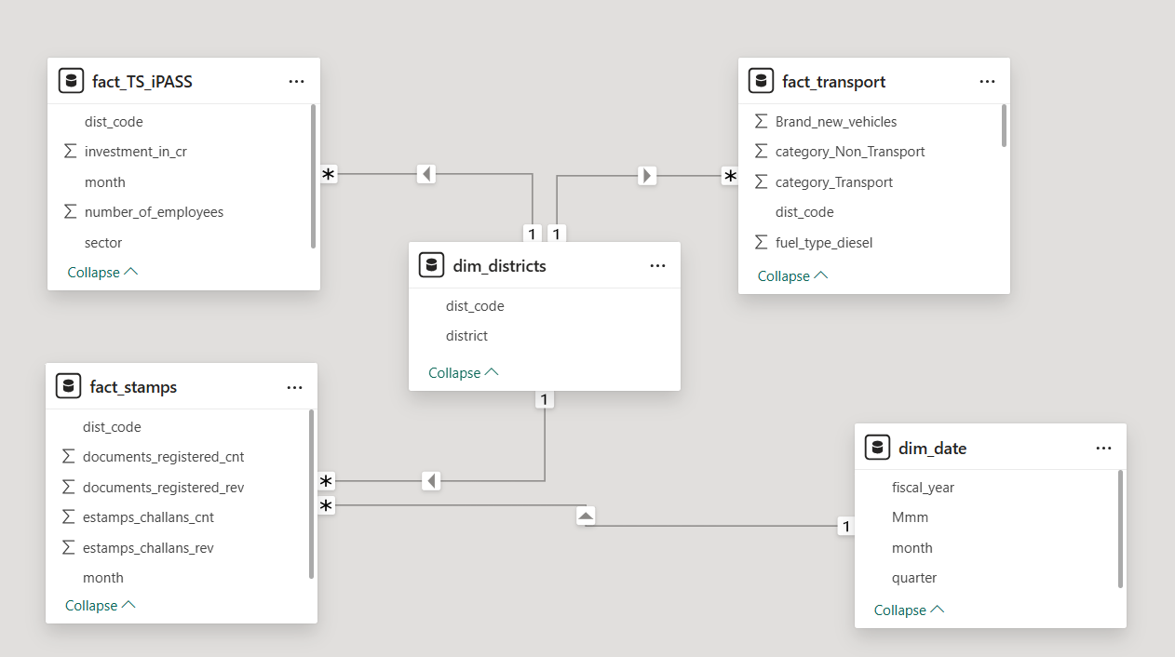
ER DIAGRAM

Slide 13
Technology Stack
Excel:
Perfect for initial data exploration, performing quick calculations, and sharing results with team members.
SQL Server:
Serves as the backbone for storing and processing structured data, enabling efficient querying and analysis across large datasets.
Power BI:
Ideal for delivering insights to business leaders and decision-makers through interactive dashboards and reports.

Slide 14
List Of Data Checks
Checking missing values.
Checking duplicated values.
Checking if any rows have negative values.
Checking name convention.
Checking all columns has proper data types.
Checking each row represents one district-month combination.

Slide 15
KPI & Formula
Document & Stamps KPIs | Formula | Description
Total Document registered | sum(documents registered cnt) | Total count of document registered
Total revenue from stamps | SUM(estamps challan rev) | Total revenue generated via stamps
Total revenue from documents registered | sum(documents registered rev) | Total revenue generated via document registered
Average Revenue per stamps | Total revenue / total stamps | Stamps per revenue registered
Average Revenue per document | Total revenue / total documents | Document per revenue registered
Top performing district | RANK(District, SUM(documents registered cnt)) | Top N districts by total documents
Stamp Penetration Rate | Stamp Penetration Rate = DIVIDE( SUM(stamps[ stamps challans cnt]), [Total Documents Registered] | Shows how many documents are being converted to digital stamps

Slide 16
Metrics for Stamp & document
Metrics | Values
Total Document registered | 5M
Total revenue from stamps | 220.68bn
Top performing district | Yadadri Bhuvanagiri with 262167 document count
Average Revenue per stamps | 75.4K
Average Revenue per document registered | 60.6K
Total revenue from document registered | 295bn
Stamp Penetration Rate | 60.06%

Slide 17
KPI & Formula
Transports KPIs | Formula | Description
Total fuel type vehicles | Petrol + diesel + electric + others | Total number of fuel type vehicles registered
Total class vehicles | Motorcycle + motorcar+ autorickshaw + agriculture + others | Total number of vehicles class registered
Percentage of brand-new vehicles | New Vehicles / (New + Used) * 100 | Percentage of new vehicles
Percentage of transports vehicles | Transport vehicles / (Transport + Non-Transport) * 100 | Percentage of transports vehicles
Total seat capacity vehicles | seatCapacity_1_to_3 + seatCapacity_4_to_6 + seatCapacity_above_6 | Total number of seat capacity vehicles
District-wise EV Adoption | Electric Vehicles (District X) / Total Vehicles (District X) * 100 | Electric vehicles per district
Average Seat Utilization | Avg passengers = seat capacity vehicles/ total vehicles | Avg. passengers per vehicle

Slide 18
Metrics for Transportation
Metrics | Values
Total fuel type vehicles | 66.67Lakhs
Total no. of vehicles class | 48.10 lakhs
Percentage of brand-new vehicles | 93.27%
Percentage of transports vehicles | 8.98%
Total seat capacity vehicles | 66.63Lakhs
Avg. passengers per vehicle | 2.6400
EV adoption percentage(for Hyderabad) | 2.79%

Slide 19
KPI & Formula
iPASS KPIs | Formula | Description
Total investment | sum(investment in cr) | Sum of investment amounts (INR)
Total employment generated | sum(number of employee) | Total jobs created
Total sectors | Sum(sectors) | Number of sectors
Monthly growth rate | current month - previous month) / previous month * 100 | MoM change in investment
Sector-wise Investment & Jobs | sum(investment in cr) / sector, sum(number of employee) /sector | Share of each sector in investment
Sector-wise Labour Efficiency | (Jobs by Sector) / (Investment by Sector) * 10000000 | Jobs per crore invested by sector
Average investment per sector | Average(Total investment / total sector) | Average investment per sector

Slide 20
Metrics for iPASS
Metrics | Values
Total investment | ₹ 99.13k crores
Total employment generated | 675k
Monthly growth rate | 0.08
Total sectors | 20
Average investment per sector | ₹ 4,956.67 crores
Sector-wise Investment & Jobs (Real Estate, Industrial Parks and IT Buildings) | ₹29778.1741 crores & 352558 jobs
Labour efficiency per employee (Solar and Other Renewable Energy) | ₹ 1.436 crores

Slide 21
Analysis to be made
Stamp registration over time
Bar chart : Fiscal Year x Quarter vs Total Documents
Line chart : Trend over time
Top performing district by stamp revenue
Bar chart : Top 10 districts by revenue
Bar chart: Bottom 10 district by revenue
3. Electric vehicle trends
Line chart : EV adoption trend over time
Stacked bar chart : Fuel types per quarter
4. Industrial Investment by Sector
Pie chart : Share of investment by sector
Bar chart : Top 10 sectors by investment
5. Job creation by sector
Bar chart : Jobs created per sector
Combo chart : Investment vs Employment comparison
6. District-wise job creation
Bar chart : Top 10 districts by jobs
Heatmap : District-wise job density
7. Vehicle class distribution
Bar chart : Total vehicles per class
Pie chart : % distribution
8. Stamp Registration vs Industrial Investment Correlation
Dual-axis line chart : Document registrations vs Investment trends

Slide 22
Dashboard layout
Documents & Stamps
Documents & Stamps
Next Page
Clear all Slicers
Slicers : Fiscal Years
Count of document vs count of stamp registered :
line chart : x-axis → years
y-axis →count of document and stamp
Number of document registered
Revenue of document registered
Number of stamp registered
Revenue of stamp registered
Stamp revenue distribution:
Map chart
District wise YoY Growth%:
line chart: x-axis → District
y-axis → revenue growth%
Top5 District wise revenue:
column chart: : x-axis → District
y-axis → Total revenue

Slide 23
Dashboard layout
Documents & Stamps
Previous Page
Transportation
Next Page
Clear all Slicers
Slicers : Fiscal Years
Monthly Fuel Type sold:
line chart : x-axis → moths
y-axis →Total vehicles sold
Total diesel vehicles sold
Total electric vehicles sold
Total petrol vehicles sold
Total others fuel vehicles sold
Overall vehicles sold in district:
Map chart
Top 5 District wise YoY Growth%:
line chart: x-axis → District
y-axis → YoY growth%
Distribution of vehicles:
Pie chart

Slide 24
Dashboard layout
Industrial Investment & Job Creation
Documents & Stamps
Previous Page
Clear all Slicers
Slicers : Sector
Slicers : Quarters
Slicers : Years
Investment in cr by months:
line chart : x-axis → moths
y-axis →Total investments
Total investment
Number of employee
Total sectors
Monthly growth rate
District wise investment:
Map chart
Top 5 District wise investment and employee
line chart: x-axis → District
y-axis → investment and employee
Top5 sector by employee:
column chart: x-axis→ sectors
y-axis→ number of employee

Slide 25
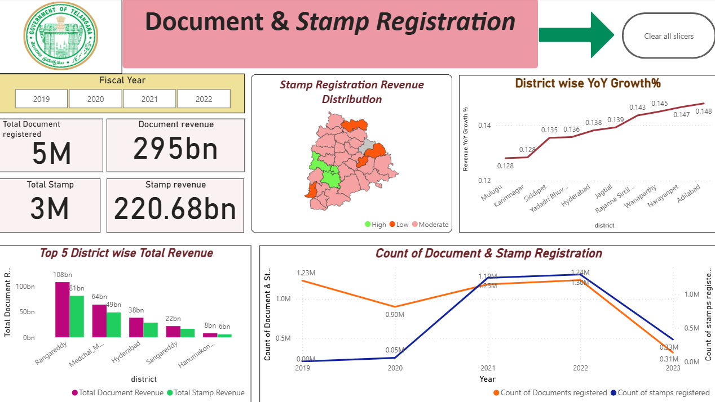

Slide 26
Insight for Document & Stamp
1. Key Metrics :
Documents Registered : 5 million.
Stamp Registrations : 3 million.
Document Revenue : ₹295 billion.
Stamp Revenue : ₹220.68 billion.
2. Count of Document & Stamp Registration Over Time :
Both document and stamp registrations show an upward trend over the years.
Stamp registration counts have consistently been lower than document registrations.
3. Revenue YoY Growth :
Revenue growth has been steady, with significant increases observed over time.
4. District-wise Revenue Distribution :
Some districts (e.g., Rangareddy) contribute significantly more revenue compared to others.
5. Top 5 Districts by Total Revenue :
Rangareddy leads in total revenue, followed by Medchal Malkajgiri and Hyderabad.

Slide 27
Recommendation & Stakeholders
Recommendations
Focus on High-Revenue Districts : Implement strategies to maintain or increase revenue in top-performing districts.
Digital Transformation : Enhance e-stamping adoption to streamline processes and reduce manual errors.
Seasonal Analysis : Identify peak periods for document and stamp registrations to optimize resource allocation.
Stakeholders
Revenue Department : Track revenue collection and ensure compliance.
Tax Collectors : Monitor stamp duty collections and identify areas for improvement.
IT Teams : Support digital initiatives like e-stamping to improve efficiency.
Public Awareness Campaigns : Educate citizens about the benefits of electronic stamping.

Slide 28
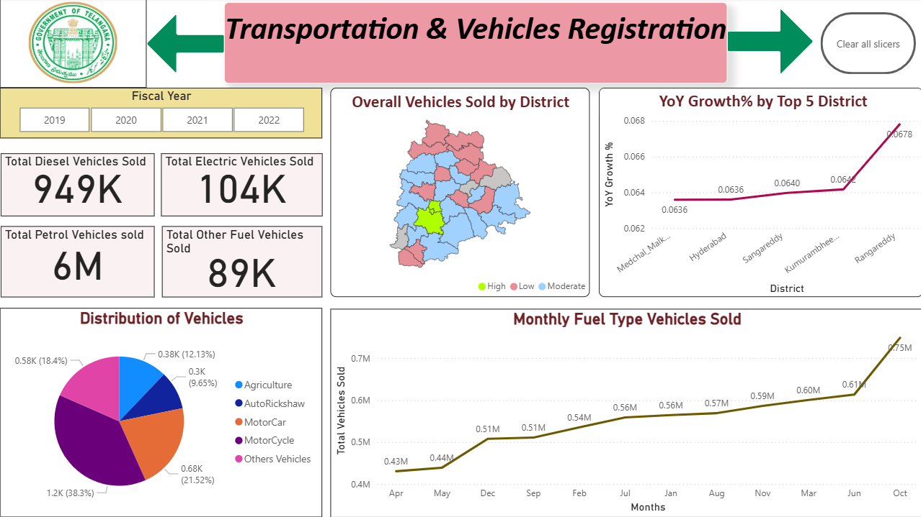

Slide 29
Insight for Transportation
1. Vehicle Sales Summary :
Total diesel vehicles sold: 949K .
Total electric vehicles sold: 104K .
Total petrol vehicles sold: 6M .
Total other fuel vehicles sold: 89K .
2. Monthly Fuel Type Vehicles Sold :
Electric vehicle sales show consistent growth over time.
Diesel and petrol vehicle sales remain stable but lower compared to electric vehicles.
3. Overall Vehicles Sold by District :
Districts like Hyderabad and Rangareddy show higher vehicle sales compared to others.
4. YoY Growth by Top 5 Districts :
Rangareddy exhibits the highest year-over-year growth in vehicle sales.
5. Distribution of Vehicles :
Motorcycles account for 21.52% of total vehicles sold, followed by agriculture vehicles (18.4% ) and auto-rickshaws (12.13% )

Slide 30
Recommendation & Stakeholders
Recommendations
Promote Electric Vehicles : Continue incentivizing EV adoption to reduce pollution and dependency on fossil fuels.
District-Specific Strategies : Address low vehicle sales in underperforming districts through targeted campaigns.
Fuel-Type Analysis : Monitor the shift towards electric vehicles and plan infrastructure accordingly (e.g., charging stations).
Seasonal Trends : Identify peak sales periods for different vehicle types to optimize inventory and marketing efforts.
Stakeholders
Transportation Authorities : Monitor vehicle sales trends and plan infrastructure improvements.
Environmental Agencies : Track EV adoption to meet sustainability goals.
Urban Planning Departments : Plan road expansions and parking facilities based on vehicle distribution.

Slide 31
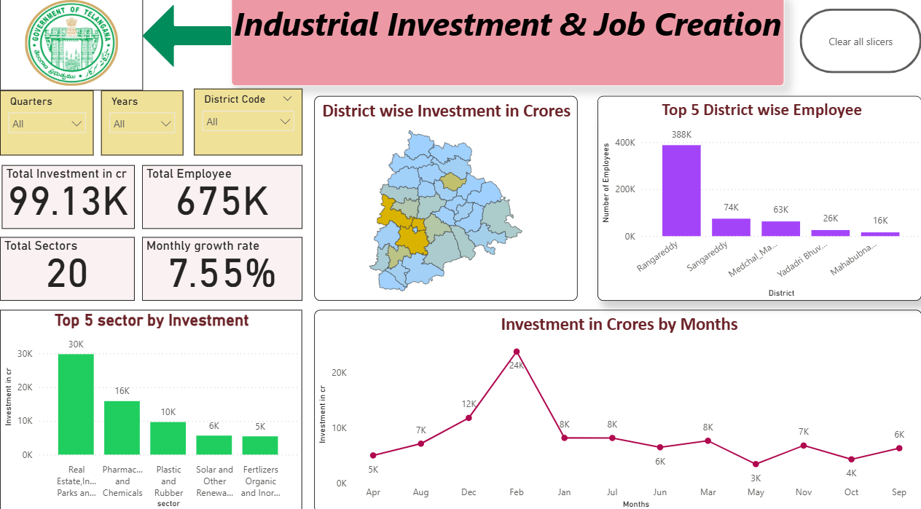

Slide 32
Insight for TS iPASS
1. Investment in Crores :
Total investment across sectors is ₹99.13K crore .
Number of employees generated is 675K .
There are 20 sectors involved, with a monthly growth rate of 0.08 .
2. Investment by Months :
Investment peaks in February (₹24K crore) and dips in March (₹8K crore) .
A general upward trend is visible from April to February, followed by a decline in March.
3. District-wise Investment :
The map shows varying levels of investment across districts, with some districts having significantly higher investments than others.
4. Top 5 Districts by Employee and Investment :
Rangareddy leads in both employee generation and investment.
5. Top 5 Sectors by Investment :
Real Estate, Industrial Parks, and IT Buildings dominate the investment landscape.

Slide 33
Recommendation & Stakeholders
Recommendations
Focus on High-Investment Districts : Allocate resources to districts like Rangareddy to sustain high investment trends.
Sector Diversification : Encourage investment in other sectors beyond real estate to balance economic growth.
Monthly Growth Monitoring : Track monthly fluctuations closely to identify seasonal patterns or anomalies.
Stakeholders
Government Officials : Monitor overall investment and employment trends.
Business Investors : Identify high-potential sectors and districts for future investments.
Employment Agencies : Track job creation trends to align workforce development programs.

Slide 34
Thank you

